Slide 1
E-commerce Project (Final Submission – 22/07/2018)

Slide 2
Table of Content
1
Our understanding of the scope
Understanding of the given data
Data cleaning and preparation
EDA
Derived KPIs & Modeling
Model Dashboard
Model – Deep Dive (Category wise)
EDA Plots
2
3
4
5
6
7
8

Slide 3
Our Understanding of the Scope
ElecKart is an e-commerce firm dealing mainly with electronic products
We need to understand the influence of different marketing variables.
Recommend the optimal budget allocation for different marketing levers for the next year – i.e marketing budget optimization
Solution Approach
1
Gather e-commerce domain knowledge
2
Understand the given dataset and questions that can be answered
3
Cleaning and prepare the data; with 3 category-wise data sets creation
7
4
Derived variable creation and grouping by weeks
5
6
EDA
Uni and bi -variate analysis
Multi-variate analysis; using different modeling techniques
8
Choose the best model for each segment

Slide 4
Basic Understanding of Marketing / Given Data
# of units sold
Delivery days and SLA
Categories/sub categories
Vertical
Procurement SLA
Item type = Luxury/Mass-Market
4Ps
Product
Price
Place (also time)
Promotion
Marketing Channel Investments
Customer sentiment
Discounts
Adstock
gmv
Product mrp
Pin-code
Order Payment Type
Week of the year – seasonality
Holiday / Events; isHoliday
Derived KPIs

Slide 5
Data Cleaning and Preparation(1/2)
ConsumerElectronics
Removing all the rows having NA and duplicate values
Filtering out data which does not fall within the timelines of this analysis – 1st July 2015 – 30th June 2016
Creating weeks from the date data
Converting order_id and order_item_id into proper numeric format - from scientific notation
Removing rows with negative product MRP; gmv and units
Removing rows where (product_mrp*unit) < gmv
Removing rows with negative deliverybdays and deliverycdays; assuming “\N” means no delay
Rarely SLA/procurement SLA for any delivery will be more than 2 months (60 days); hence filtering out these value
Converting cust_id and pincode into proper numeric format - from scientific notation
Computing discount % for each transaction
Computing gvm/unit
Computing ItemType – categorizing items into Luxury (priced more the 80 %tile) and Mass Market
Creating a variable date from order_date
Removing Columns which will not be used in analysis
Storing the total gmv proportion for each of the 3 categories wrt the total gvm for all items
Filtering and keeping only the 3 required categories

Slide 6
Data Cleaning and Preparation(2/2)
Media data and other information.xlsx
Loading all the 4 spreadsheets
Special Sale Calendar –
Splitting the event name and date; also converting the date in proper format
Creating event start and end date
Producing a dataframe – having all dates possible within the timeframe of analysis and corresponding event names (if any)
Merging this with consumer data – produced earlier
Monthly NPS Score –
Transposing the columns into rows
Cleaning the naming issues wrt months
Populating the same monthly scores to each day of the month
Merging this with consumer data – produced earlier
Media Investment –
Distributing the monthly investing data for each channel into daily investment – proportionate to “days in that month”
Extracting category-wise investment – proportionately to gvm of each of the 3 category wrt the total gvm
Creating 3 category-wise dataframes - Merging this with consumer data – produced earlier
Fixing the week issue – 1st week of 2016 is to be considered week # 54 (53+1) and not week # 1 – for continuation and analysis
Any item having gmv/unit more at 80%tile is assumed to be Luxury else Mass-market
Please note: At the end of this analysis we are producing 3 category wise clean .csv files

Slide 7
EDA(1/4) (on transaction data and marketing spend)
GMV: range of GMV varies from 10 to 148050. More than 50% of the values are under 600. Outliers were observed in the boxplot.
Units: Range varies from 0 to 39 units. 75% of the data contains unit values equal to 1.
Deliverybdays / deliverycdays: Initial data contained negative values that were filtered out. For both these columns range varied from 1 to 40 days and majority of the values were equal to one.
SLA: Negative values were removed , mean value of 5 days and boxplot showed values of outliers.
Order Payment Type: Two options were available(COD/Prepaid). Cash on delivery mode of payment was more popular compared to prepaid.
Product Analytic Category and Sub Category: For the purpose of this project we have considered three categories – Camera Accessories, Gaming Accessories and Home Audio.
Product MRP: Wide range of product MRP prices, which varied from 99 to 180000. Interquartile range value was 2034. Large number of outlier values were also observed.
Discount Percentage: Calculated field created doing the data preparation process. Values range from 0 to 98%.
NPS Score: It is assumed constant across the months. The range varies from 44.3 to 59.8
Media Investment Channels: Maximum investment was done in the month of October in the year 2015. For majority of the months considered, most of the total investment is coming from sponsorship funds. Online marketing comes next.
Item Type: Majority of the items sold were Mass Market Type Products.

Slide 8
EDA(2/4) (on transaction data and marketing spend)
Variation of GMV and Total Investment Spent across Months: The two lines follow similar trend lines. GMV and Total Investment peak in the month of October 2015. Lowest values for both these parameters were observed in the month of August 2015.
Variation of GMV across weeks: GMV values peak in the week 42 and are minimum in the weeks 32 – 34.
Number of Units broken down by the analytic sub category type for different months and week: Maximum number of units were sold in the month of September (week 42). For all month / week values considered, majority of units sold belonged to the Camera and Gaming Accessories sub type.
Bubble chart showing popular items sold for each category
CameraBubble Chart showing the popular items sold for each category type Accessory: Flash, Camera Battery, Camera Tripod, Lens
Gaming Accessory: Gaming Headset, Gaming Mouse, Gamepad
Home Audio: Home Audio Speakers, FM Radio, Boombox
Gaming Accessories was the category where the maximum units were sold.
Tree Plot showing Product Verticals with the Highest GMV values: HomeAudio Speakers, Lens and Gamepads are the verticals that give the highest return.
For each mode of delivery, which products were sold the most and which of them gave the highest return in terms of gmv?
Cash on delivery: Maximum units were sold for products like HomeAudio speaker, gaming headsets and gamepads. Home Audio Speakers, Lens and Gamepads gave the highest return in terms of GMV
Prepaid: Maximum units were sold for Home Audio Speakers, Camera Batteries and Gamepads. Home Audio Speakers, Lens and Gamepads gave the highest return in terms of GMV
Trend of Median Discount Percentage by Week for each sub category: Camera and Gaming Accessories show similar trends across the weeks where discount offered peaks in weeks 32-33. For Home Audio discounts decline in week 32.
Number of units sold by Item Type: Most of the units sold belonged to the mass market category. Camera and Gaming Accessories related products were sold the most.
Consumer NPS Score by week: Highest scores were observed in the weeks 32-35 , which coincided with the weeks were there was maximum discount being offered.

Slide 9
EDA(3/4) (on transaction data and marketing spend)
Distribution of SLA for each product category: Mean sla for each category is roughly the same and outliers are observed in all three categories.
Distribution of GMV for all three categories: Mean GMV for the three categories remains roughly the same. A lot of outliers are observed in the Camera Accessories category.
Distribution of discounts offered on Special Events: The range of discounts being offered is roughly the same for all events. The median discount percentage for events like Daussera and FHSD is higher than those of the other events.
Comparison of average GMV for normal days vs special days: The mean gmv comes out to be higher on special days compared to normal days.
Distribution of Discount Percentage for each Item Type: The median discount percentage offered on Mass Market goods is higher than that offered on Luxury goods. If we consider return in terms of GMV, then Luxury products give the retailer a higher return as compared to Mass Market products.

Slide 10
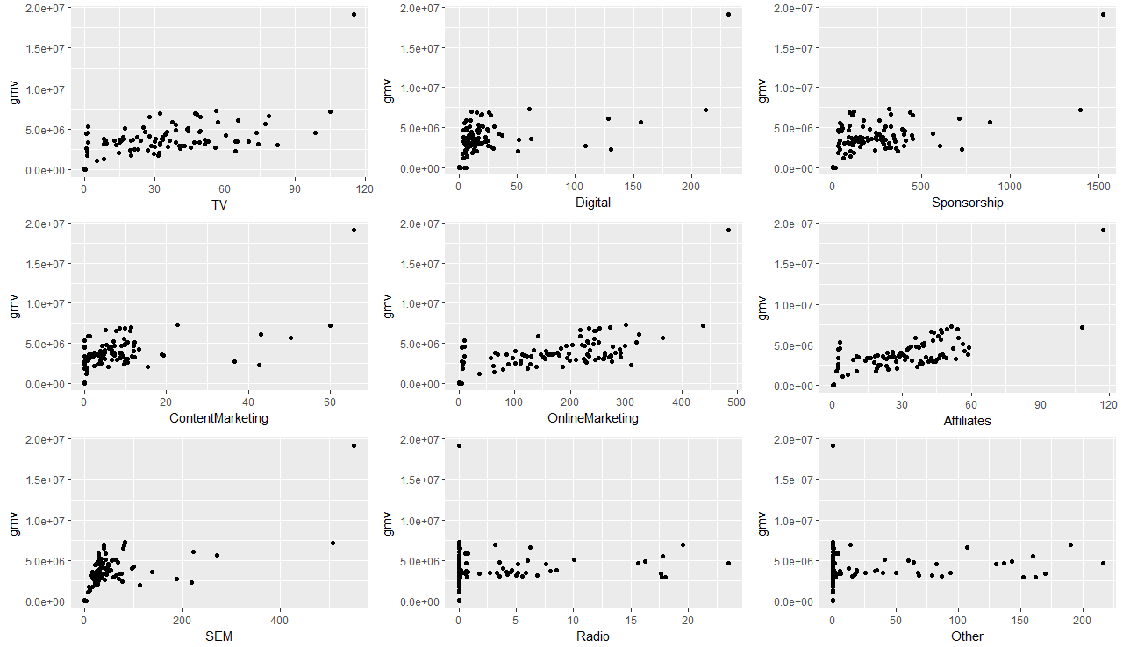
EDA(4/4) (on transaction data and adstock)
Relation between gmv and adstock of different Channels– on weekly data

Slide 11
Derived KPIs & Modeling
At the end of the last step i.e - data cleaning, preparation and merger of relevant data files – we generated 3 .csv files – one for each category on which EDA is performed
Next for each of the file – following activities are undertaken
Columns which will not add value to our analysis are dropped i.e date, SLA details
Dummies are created for Categorical Variables - product_analytic_vertical, EventName, order_payment_type etc
Derived variables are created like - Discount_Percentage, gmvperunit, EventName(whether there is any event in that timeperiod), ItemType (based on gmv unit price of the item –Luxury/Mass Market) etc
Adstocks are created for independent variables to be used for Koyck and Distributed-Lag models. 0.5 ad-stock weekly retention rate is consider till t-3 weeks
The following category specific regression models are created
Linear model
Multiplicative model
Koyck model
Distributed lag model (additive)
Distributed lag model (multiplicative)
Hierarchical model (for reference only)
Model fine tuning - We start with all variables and reduce them first using stepAIC and Boruta function; and then one variable at a time depending on vif and p-value – till we get a reasonable number of variable count with decent rsquared value
We have attempted model building via both with and without cross validation
# We have not performed scale normalization as it was distorting the model

Slide 12
Model Dashboard
r-square prediction values (without cross validation)
Model/Category | Camera Accessory | Gaming Accessory | Home Audio
Linear | 0.8266455 | 0.9036745 | 0.8938633
Multiplicative | 0.9284756 | 0.986069 | 0.9432842
Koyck | Not applicable | Not applicable | Not applicable
Distributed Lag (additive) | Not applicable | 0.9061027 | 0.9916531
Distributed Lag (multiplicative) | Not applicable | 0.9922839 | 0.9776283
r-square prediction values (with cross validation)
Model/Category | Camera Accessory | Gaming Accessory | Home Audio
Linear | 0.9927484 | 0.9474771 | 0.9960572
Multiplicative | 0.998684 | 0.9983094 | 0.9971113
Koyck | Not applicable | Not applicable | Not applicable
Distributed Lag (additive) | Not applicable | 0.6662461 | 0.9988668
Distributed Lag (multiplicative) | Not applicable | 0.6703744 | 0.9822208
# Not applicable - no significant lag variable was present in the final model

Slide 13
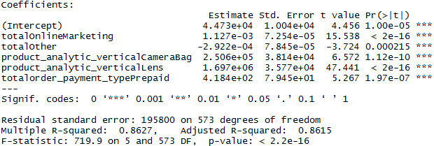
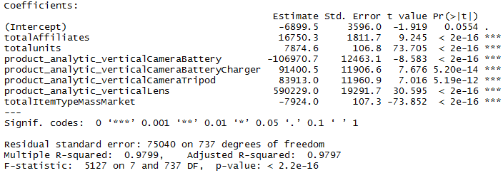
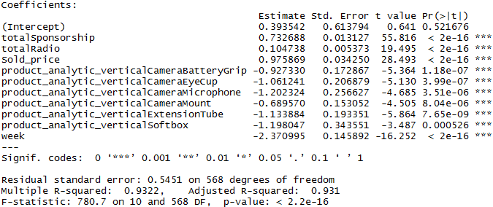
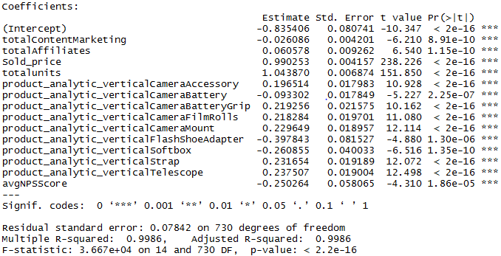
Camera Accessory
Additive (without cross validation)
Additive (with cross validation)
Multiplicative (without cross validation)
Multiplicative (with cross validation)

Slide 14
Camera Accessory
Findings
The r-square value for additive and multiplicative models are similar – with better results achieved via cross validation; multiplicative model with cross validation explains the dependent variable best
No significant lag variable was discovered; hence Koyck and distributed lag models are not being considered
Marketing channels – Affiliates have direct positive impact on gmv; but content marketing affects gmv counter productively when working in sync with Affiliates
Sponsorship, radio and online market are the other marketing channels which impact gmv positively
Products like - telescope, strap, camera mount, film rolls and battery grip increase gmv while items such as camera battery, flash shoe adapter and soft box does the opposite
NPS score is showing an inverse relation with gmv
Prepaid payments improves gmv while mass-market items have a negative effect

Slide 15
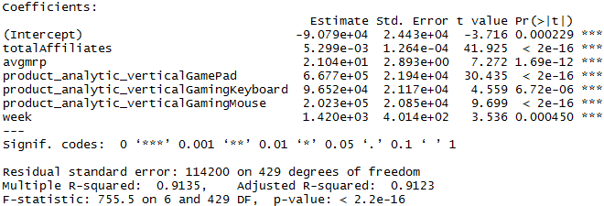
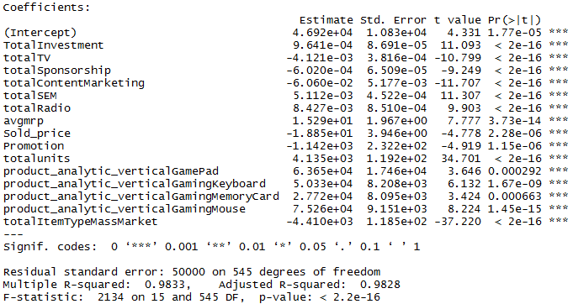
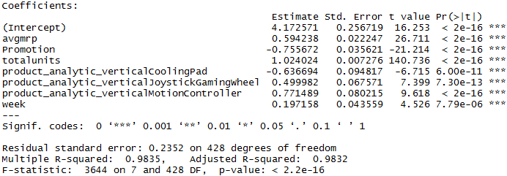
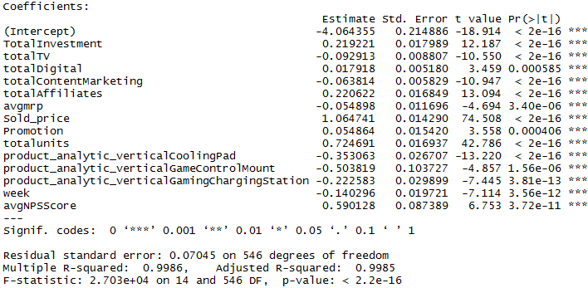
Gaming Accessory
Additive (without cross validation)
Additive (with cross validation)
Multiplicative (without cross validation)
Multiplicative (with cross validation)

Slide 16
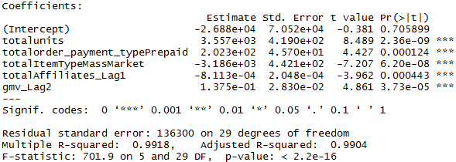
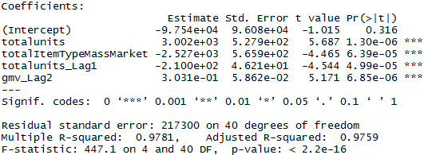
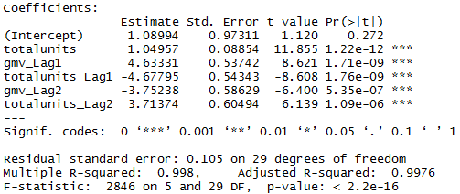
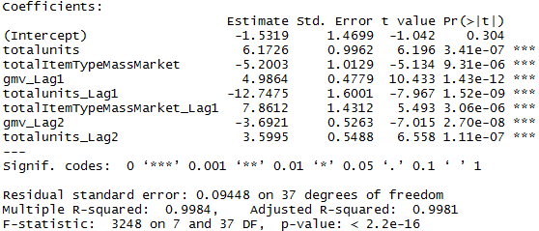
Gaming Accessory
Distributed Lag (Additive) - without cross validation
Distributed Lag (Additive) - with cross validation
Distributed Lag (Multiplicative) - without cross validation
Distributed Lag (Multiplicative) - with cross validation

Slide 17
Gaming Accessory
Findings
The r-square value for additive and multiplicative models are similar – with better results achieved via cross validation; multiplicative model with cross validation explains the dependent variable best
Distributed lag models provide useful insights - but have relatively lower predictive power
Marketing channels – total investment on marketing spent helps gmv with Affiliates having the most direct positive impact on gmv along with Digital; TV and content marketing affects gmv counter productively when working together
Radio and SEM are also good for gmv
Promotions, number of units sold and sold price increase gmv while higher mrp do not
Products like – pad, keyboard, memory card and mouse improve gmv value but cooling pad, game control mount and game charging station reduce the same
NPS scores have a direct relation with gmv; but mass market products have a negative impact on gmv
gmv_lag_1 (1 week lag) is good for the gmv while totalunit_lag_1 (1 week lag) is counter productive; on the other had totalunit_lag_2 (2 weeks lag) is helps increase gmv; Interestingly gmv_lag_2‘s (2 weeks lag) effect is also good when considered alone but it becomes adverse when in sync with other lag variables

Slide 18
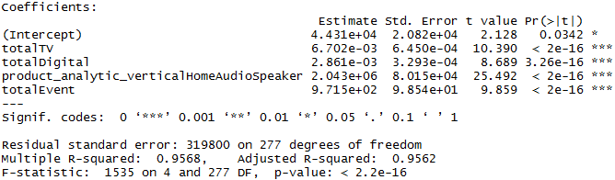
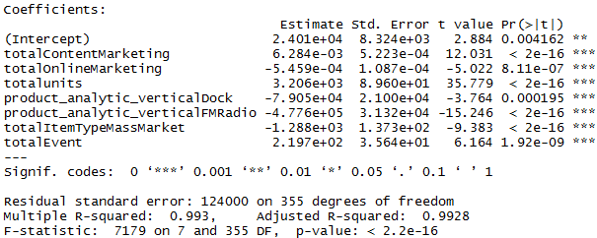
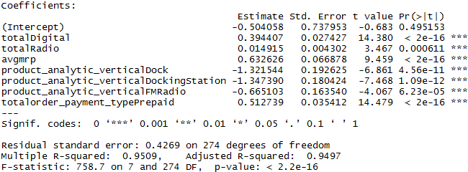
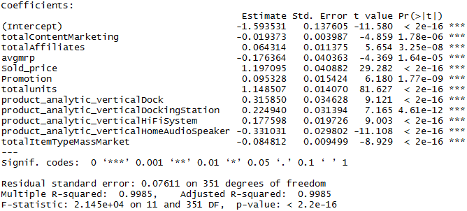
Home Audio
Additive (without cross validation)
Additive (with cross validation)
Multiplicative (without cross validation)
Multiplicative (with cross validation)

Slide 19
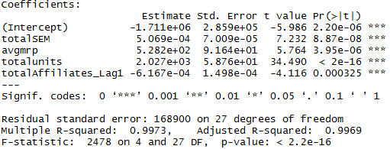
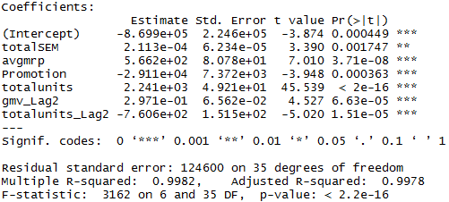
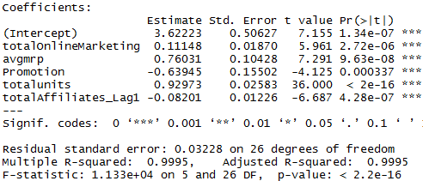
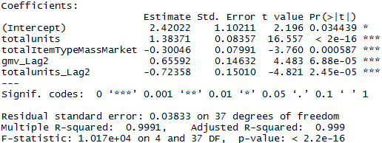
Home Audio
Distributed Lag (Additive) - without cross validation
Distributed Lag (Additive) – with cross validation
Distributed Lag (Multiplicative) – without cross validation
Distributed Lag (Multiplicative) – with cross validation

Slide 20
Home Audio
Findings
The r-square value for additive and multiplicative models are similar – with better results achieved via cross validation; distributed lag models have a slightly better predictive power than the rest
Marketing channels – SEM is the most influential channel having a positive impact on gmv
Content marketing play a positive role while working alone and online marketing does the opposite; affiliates work in favor of gmv when working in sync with content marketing (countering its adverse effect)
As expect, total units increases gmv along with mrp; promotion seems to be counter productive
Products like docking station and HiFi-system as good for gmv value but FMRadio and home audio speaker reduces the same
Events improve gmv while mass market items effect gmv adversely
gmv_lag_2 (2 week lag) is good for the gmv while totalunit_lag_2 (2 week lag) decreases the same; adverse lag effect of affiliates may also be present

Slide 21
Excel Plot
The maximum investment occurred between the weeks 39-45.
Most investment was done through the Sponsorship Media.

Slide 22
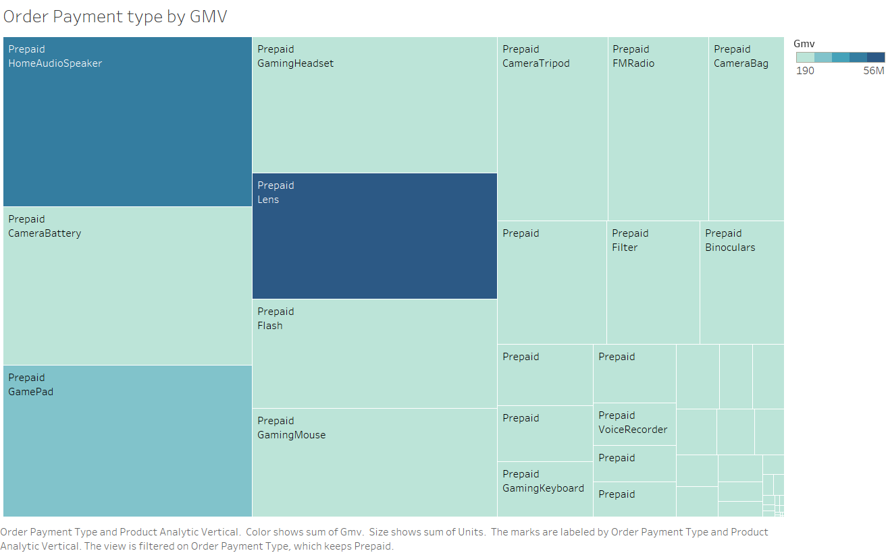
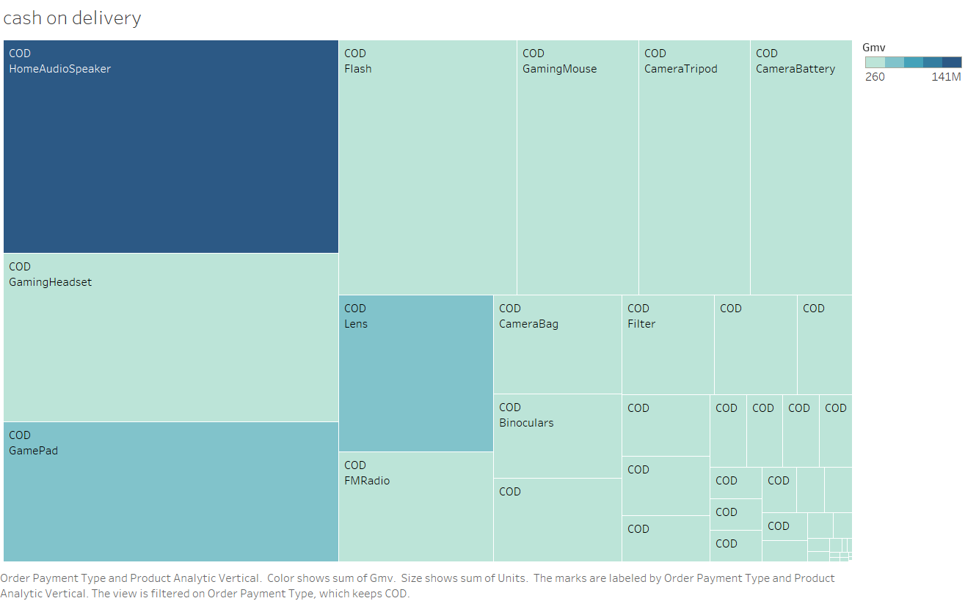
Tableau Plots
For each mode of delivery, which products were sold the most and which of them gave the highest return in terms of gmv?
Cash on delivery: Maximum units were sold for products like HomeAudio speaker, gaming headsets and gamepads. Home Audio Speakers, Lens and Gamepads gave the highest return in terms of GMV
Prepaid: Maximum units were sold for Home Audio Speakers, Camera Batteries and Gamepads. Home Audio Speakers, Lens and Gamepads gave the highest return in terms of GMV

Slide 23
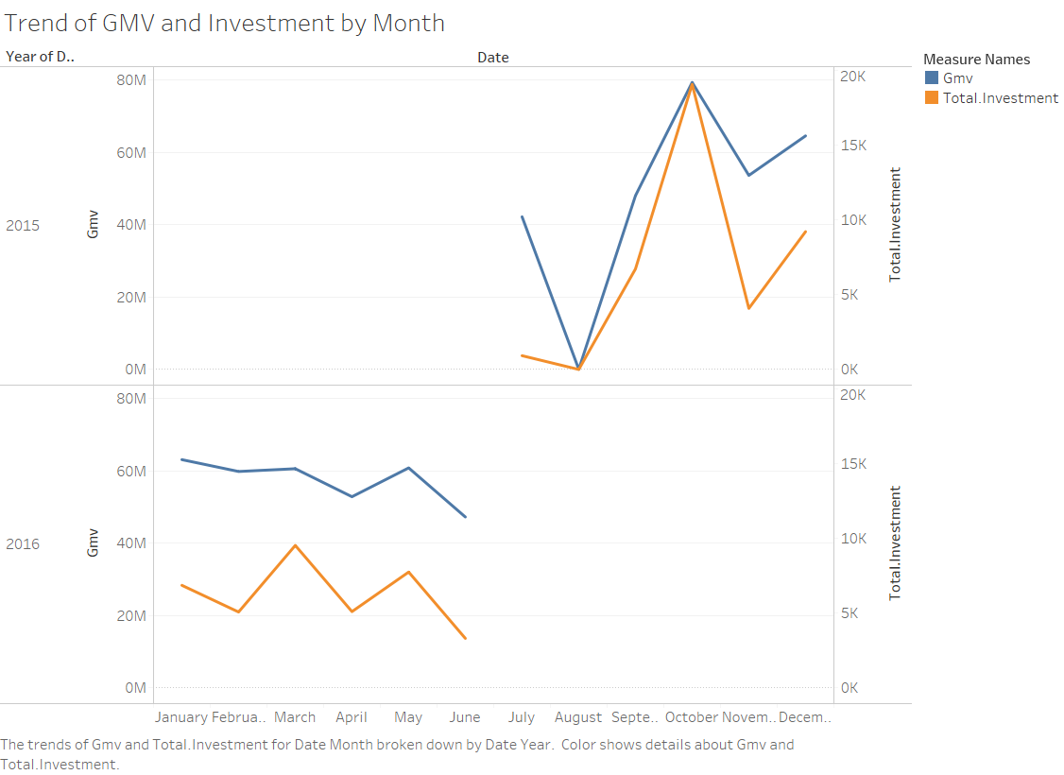
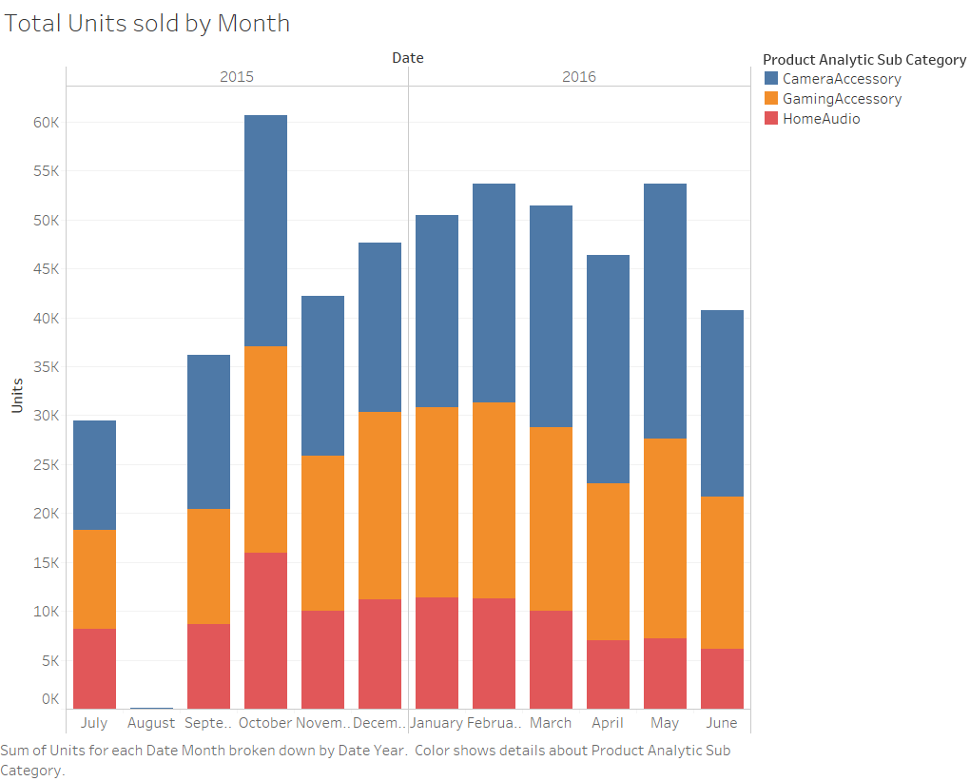
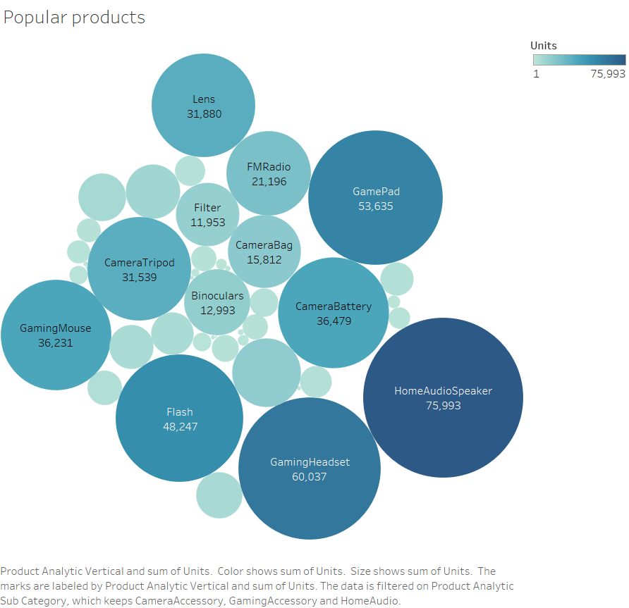
The two lines follow similar trend lines. GMV and Total Investment peak in the month of October 2015. Lowest values for both these parameters were observed in the month of August 2015.
Maximum number of units were sold in the month of September (week 42). For all month / week values considered, majority of units sold belonged to the Camera and Gaming Accessories sub type.
Bubble Chart shows the popular items sold for each category type:
For each category , the following products are the most popular( most number of units sold)
Camera Accessory: Flash, Camera Battery, Camera Tripod, Lens
Gaming Accessory: Gaming Headset, Gaming Mouse, Gamepad
Home Audio: Home Audio Speakers, FM Radio, Boombox
Gaming Accessories was the category where the maximum units were sold.

Slide 24
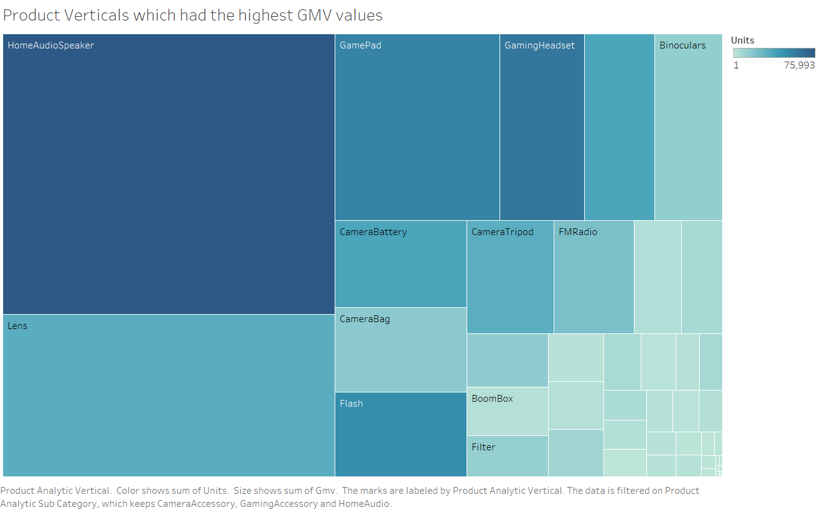
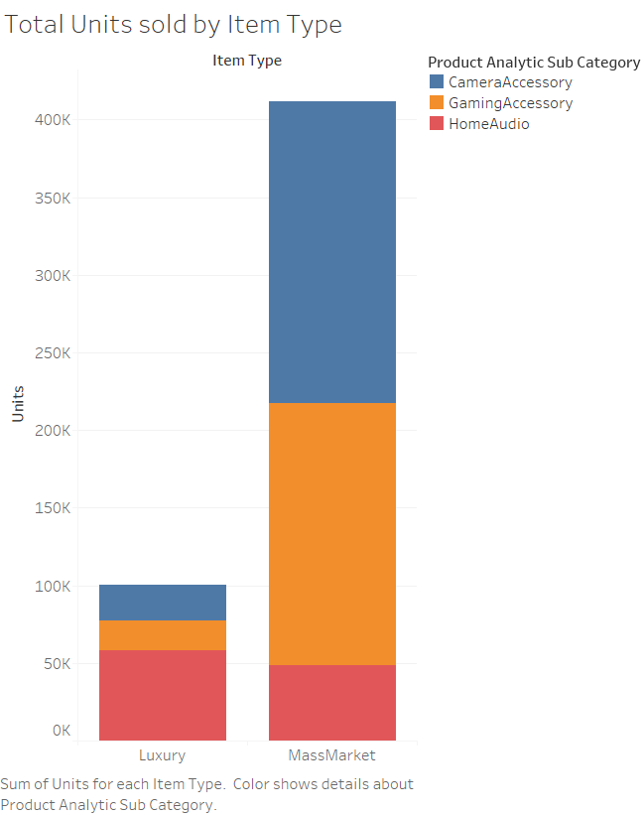
Tree Plot showing Product Verticals with the Highest GMV values: HomeAudio Speakers, Lens and Gamepads are the verticals that give the highest return.
Most of the units sold belonged to the mass market category. Camera and Gaming Accessories related products were sold the most.

Slide 25
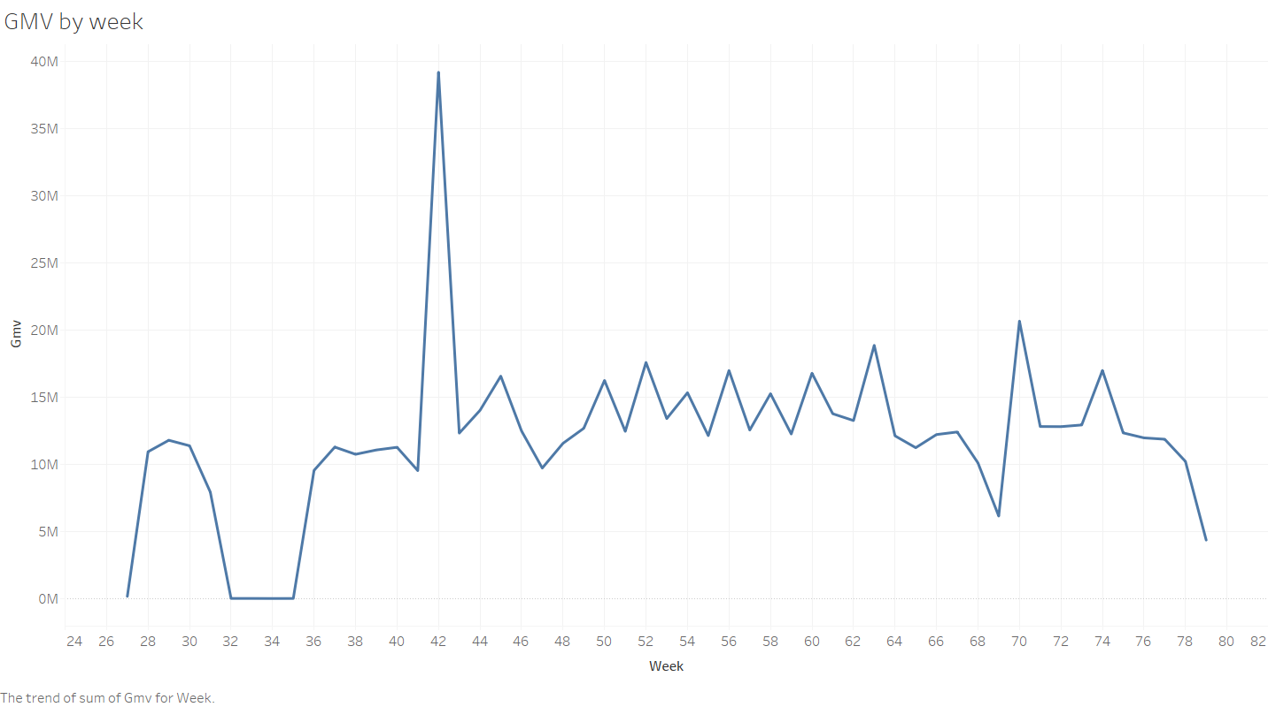
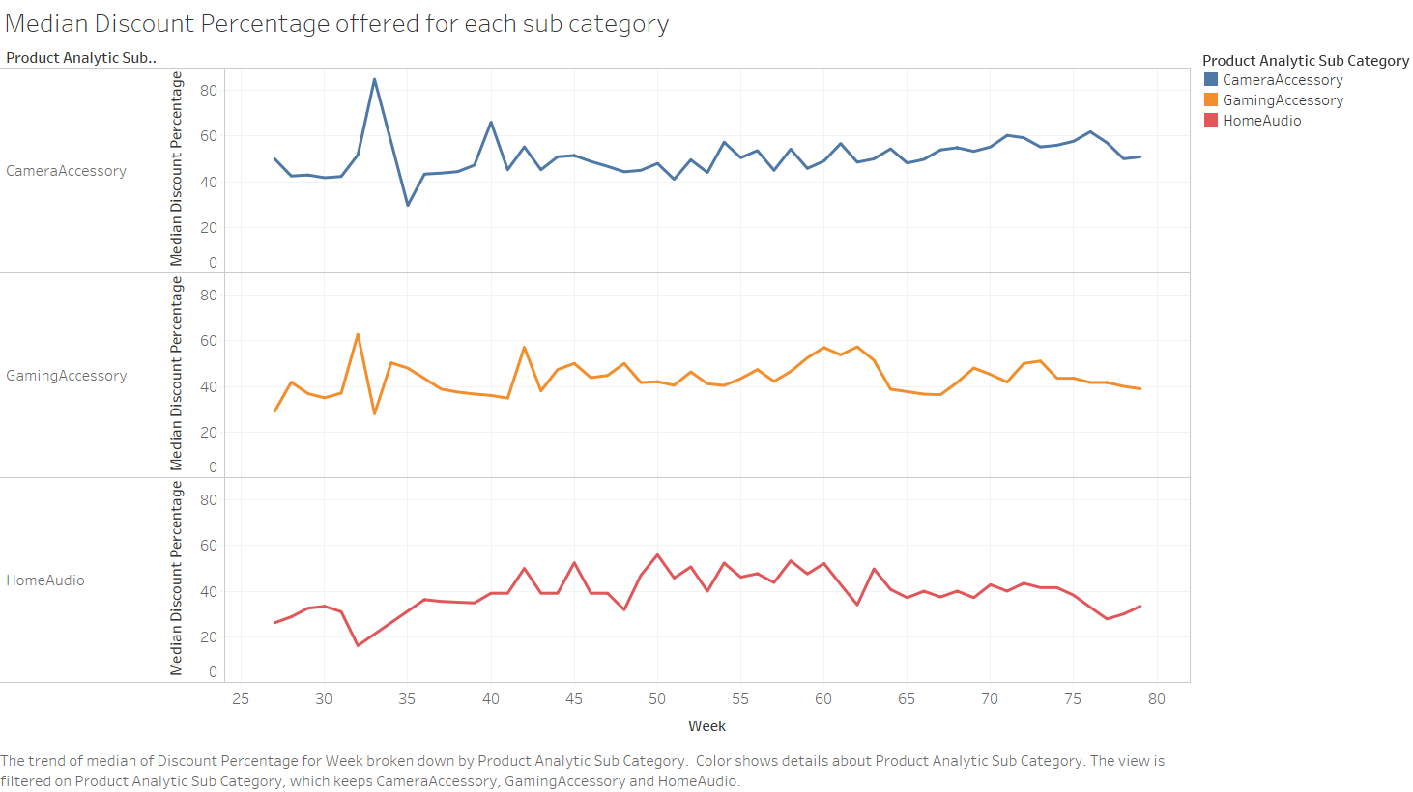
GMV value peaked in the week 42 and hit the lowest in weeks 32- 35
For Camera and gaming accessories discount percentages peaked in the weeks 32 , 33.
A reverse trend was noted in Home Audio category

Slide 26
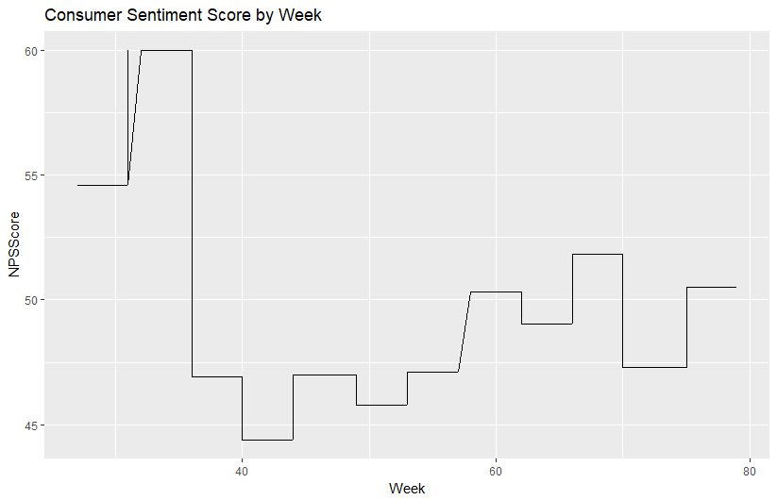
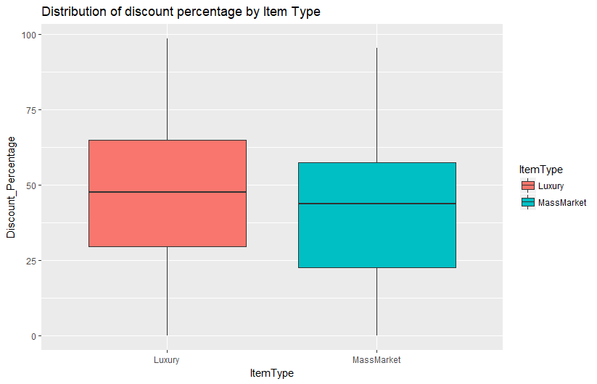
R Plots
Consumer NPS score is highest in weeks 32 – 35 , which coincides with the time when maximum discounts were being offered
The median discount percentage offered for luxury items is more compared to Mass Market Products.

Slide 27
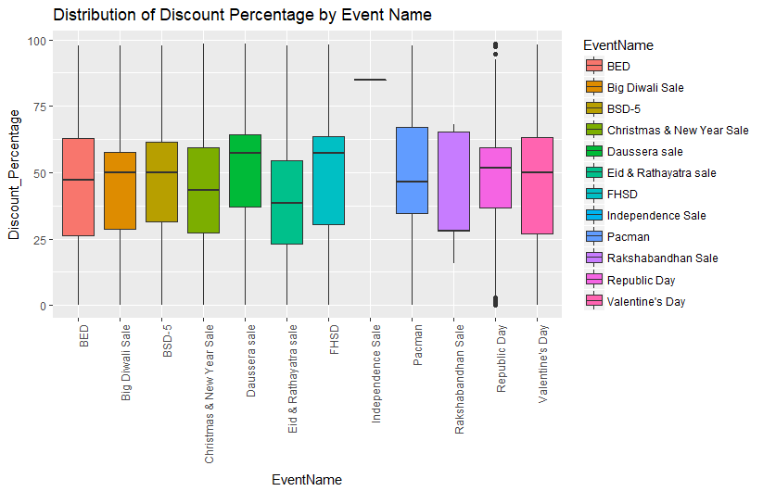
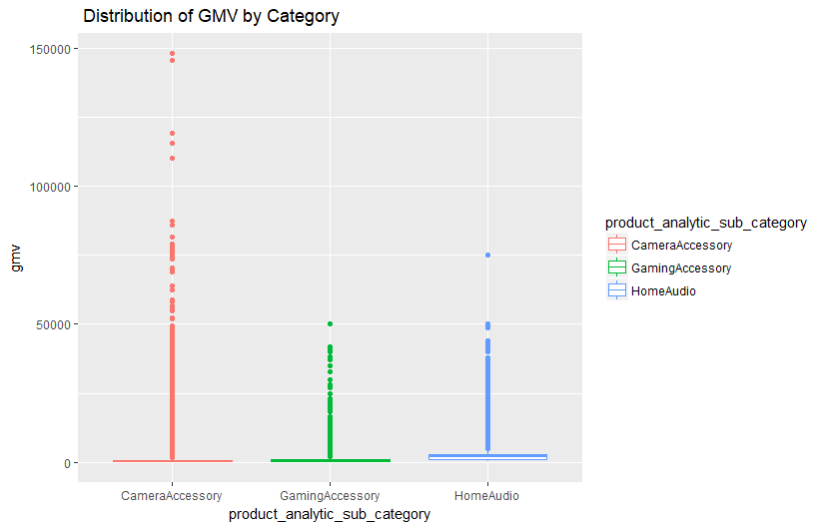
The range of discounts being offered is roughly the same for all events. The median discount percentage for events like Daussera and FHSD is higher than those of the other events.
Mean GMV for the three categories remains roughly the same. A lot of outliers are observed in the Camera Accessories category

Slide 28
Thank You!!!

